Slide 1
Mail Server Setup
MAIL SERVER SETUP

Slide 2


Mail Architecture
Mail Server Setup
Internet
Mail
Server
Mail
Server

Slide 3
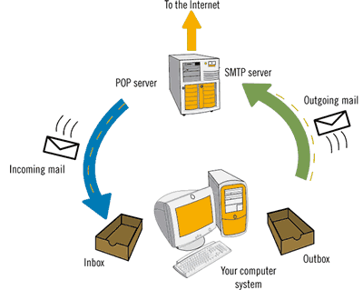
Mail Architecture
Mail Server Setup

Slide 4
Mail Architecture
Mail Server Setup
Simple Mail Transfer Protocol (SMTP) is used to transfer mail between Mail Servers over Internet
Post Office Protocol (PoP) and Internet Message Access Protocol (IMAP) is used between Client and Mail Server to retrieve mails

Slide 5
Sendmail Configuration
Mail Server Setup
Daemon: sendmail
Configuration File: /etc/mail/sendmail.mc
Edit the following lines
  LOCAL_DOMAIN(`localhost.localdomain')dnl
  DAEMON_OPTIONS(`Port=smtp,Addr=127.0.0.1, Name=MTA')dnl
Run “make –C /etc/mail” command to compile sendmail.mc and generate sendmail.cf file.
Restart sendmail and watch for errors

Slide 6
PoP & IMAP Server
Mail Server Setup
PoP3 & IMAP Server can be started using dovecot server (service dovecot restart).

Slide 7
Linux Router Setup
LINUX ROUTER

Slide 8
Linux Router
Linux Router Setup
Install two Network Cards
Configure the two network cards to belong to two networks
Edit the following line in /etc/sysctl.conf and reboot
net.ipv4.ip_forward=1
(The default value is 0)

